Slide 1



Slide 2


Welcome to Computing@YSJ
No fire alarms planned today
Fire meeting point grassed area on Lord Mayors Walk
No Smoking Campus
Free cash machine near dining room
Main Reception in Holgate
First Aid – Security 01904 876444

Slide 3

YORK ST JOHN
Established in 1841
Became a University in 2006
6,400 students from over 80 countries
City centre based campus
94% of 2015 graduates in Employment or further Study
70% of our students achieve a 1st or 2:1
£110 million investment
Over 140 different Undergraduate programmes
Postgraduate opportunities available

Slide 4

Degrees
BSc Computer Science
BSc Computer Science (with year in Industry)
BSc Cyber Security
BSc Cyber Security (with year in Industry)
BSc Games Development
BSc Games Development (with year in Industry)
BSc Software Engineering
BSc Software Engineering (with year in Industry)
Postgraduate
MSc by research – York Campus
PhD - York Campus
MSc by taught - London Campus

Slide 5

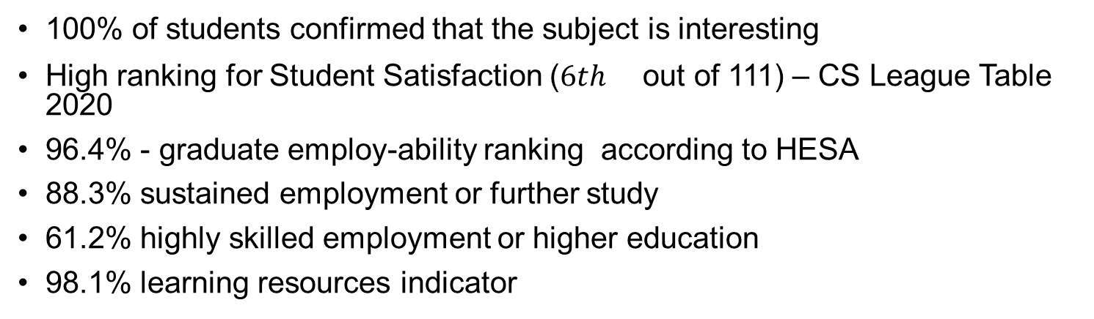
Key stats.
100% of students confirmed that the subject is interesting
High ranking for Student Satisfaction (${6th }^{}$ out of 111) – CS League Table 2020
96.4% - graduate employ-ability ranking according to HESA
88.3% sustained employment or further study
61.2% highly skilled employment or higher education
98.1% learning resources indicator

Slide 6

Computing at York St John
We are small. We have a maximum size of 36/40 per lab.
Our staff know their students and they work with them throughout the degree.
The programmes were designed so that rather than teach at you the idea is to teach with you. The programme has high contact time and a high proportion of classes that are practical and hands on.
Typical year group size 50 –60 students

Slide 7
Computing at York St John – The Environment
Dedicated Lab and Workspaces
Combination of Windows, Mac and Linux environment Plus mobile platforms (Android, iOS), Arduino and Raspberry Pi
Access to the lab, outside session times normally 24 hours a day (excluding summer holidays – open until 9pm)

Slide 8
A practical degree
1 Hr Lecture, 3Hrs Practical in a week for each module
Authentic and relevant to practice
Direct learning activities in skills lab (simulation)
Supportive & Co-operative
Work in small groups
Support each other
Set goals
Opportunity to know each other.
Supported Open Learning (SOL)
Working with technicians and students to explore cases, answer questions, solve problems
Our approach to teaching and learning

Slide 9
Contacts – if you have any further questions
Computer Science & Software Engineering – Dr Mike ODea m.odea@yorksj.ac.uk
Games Development – Dr Andy Guest a.guest@yorksj.ac.uk
Cyber Security and Postgraduate studies – Dr Aminu Usman a.usman@yorksj.ac.uk

Slide 10

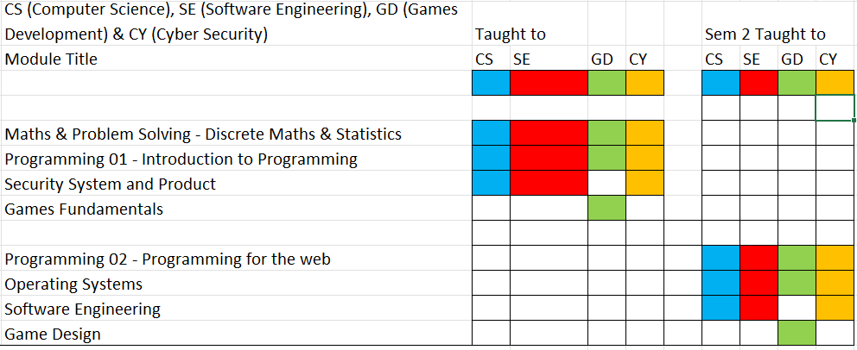
Course Structure – Year 1

Slide 11

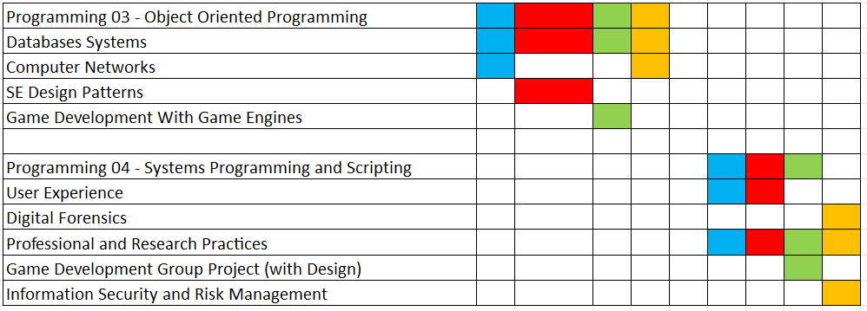
Course Structure
Year 2

Slide 12

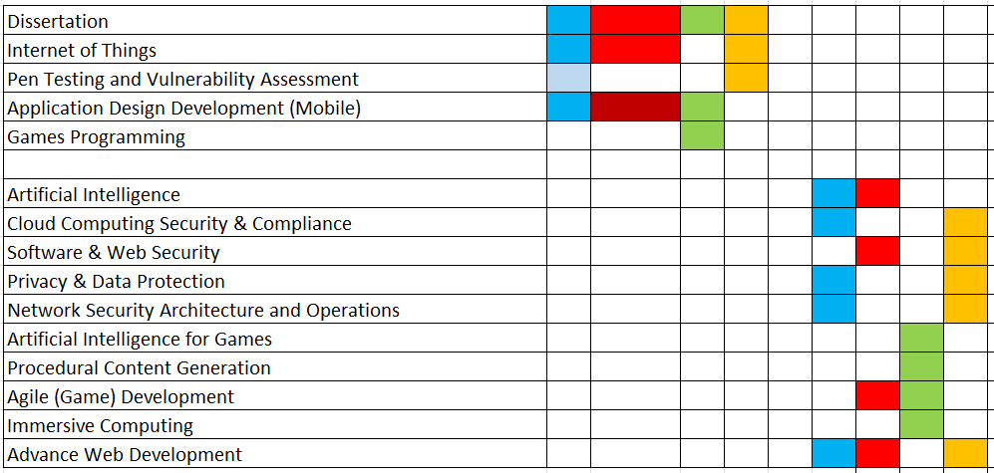
Course Structure
Year 3

Slide 13


Our approach to assessment
Diverse range of assessment methods
Formative and Summative assessments
Practical: 21% of the assessments
Help students understand the application to practical programming of the theory that is taught in lectures.
Portfolio assessment: 55% of the assessments
Enables students to reflect on their real performance, to show their weak and strong domain, and to observe student’s progress during the learning process
Presentation: 3% of the assessments
Presentation skills, and prepare students to research, prepare and deliver a technical presentation.
Written work: 13% of the assessments
Improve students writing skills, analytical and cognitive abilities
Exam: 7% of the assessments
To generate competition among students, problems solving while in a controlled environment and push and pressure that every student necessitates in life
Notes:
The programme is designed with a diverse range of assessment methods to enhance and reinforce student learning experience and to deliver opportunities for students to achieve the learning outcomes

Slide 14

Computing at York St John – Other than Teaching
We have a strong employment figures. Almost 100% employment or post-graduate education for graduates over the past four years.
Work placement scheme - students have undertaken placements with local industry partners and organisations such as York City Council, Elvington Aircraft Museum, the National Railway Museum and the York International Shakespeare Festival.
Field trips - Bletchley Park, the Gadget Show Live, Berlin Computing Museum.
The course integrates professional qualifications alongside academic qualifications, e.g. Microsoft MTA.

Slide 15

Languages
General Programming Languages
Python, C#, Java, C++
Web Programming
HTML, CSS, PHP, Javascript, JQuery, JSON, AJAX etc…
Database Programming
SQL, XML
Specialist Languages
Linux shell scripting, R, UML, Assembler

Slide 16

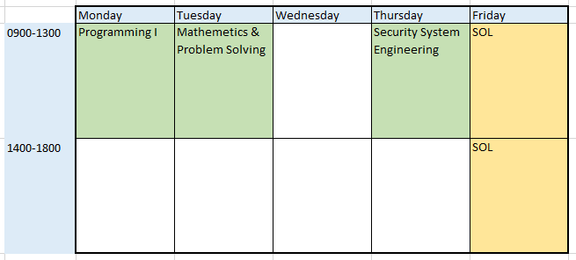
Contact time / example of a timetable

Slide 17
Professional certifications
1. Employability
1.1 A short course – “the Certificate in Career thinking” organised by Careers team at York St John University.
1.2 Students are supported to gain professional certifications, accreditation, and membership, e,g.
Microsoft MTA Exams
Microsoft Azure Fundamentals – AZ-900
Microsoft Azure AI Fundamentals – AI-900
New ones for Cyber Security students
Offensive Security Certified Professional (OSCP)
Certified Data Privacy Solutions Engineer (CDPSE)
2. Research Practices
Research methods, qualitative, quantitative research, data collections methods and experiment, analysis

